Slide 1


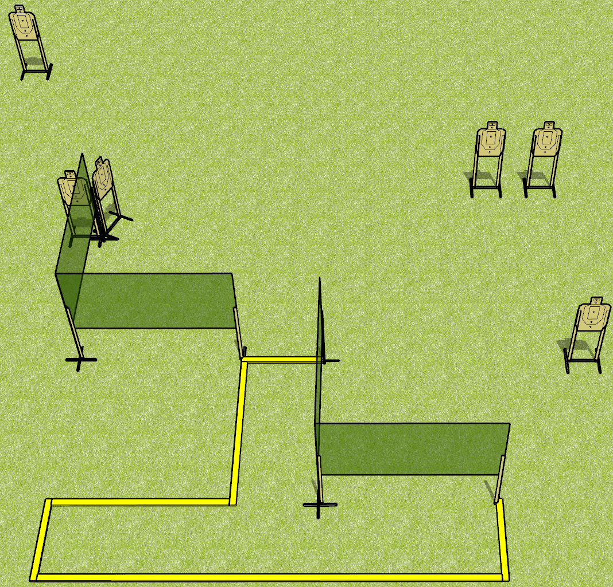
 | Dothan Gun Club – USPSA Match Hang On, What? Course Designer : Drew Coleman
Round Count 18 rounds 6 USPSA targets
Equipment List 3 medium fault lines 6 wall feet

Slide 2
Hang On, What?
Written Stage Briefing
Hang On What is an 18 round, 90 point, standard exercise. There are 6 USPSA targets. The best 3 hits on paper will score. The start signal is audible.
Handgun is loaded and holstered, wrists below belt.
Loaded carbine is held with both hands, stock on belt, safety on.
Stage Procedure:
String 1: start position is inside shooting area. On start signal, engage each target with only 1 round each from within the shooting area.
String 2: start position is inside shooting area, toes against front fault line. On start signal, engage each target with only 1 round each strong hand only from within the shooting area.
String 3: start position is inside shooting area. On start signal, engage each target with only 1 round each weak hand only (weak side for PCC) from within the shooting area.

Slide 3
 | Dothan Gun Club – USPSA Match Hang On, What? Course Designer : Drew Coleman
Round Count 18 rounds 6 USPSA targets
Equipment List 3 medium fault lines 6 wall feet

Slide 4
Hang On, What?
Written Stage Briefing
Hang On What is an 18 round, 90 point, standard exercise. There are 6 USPSA targets. The best 3 hits on paper will score. The start signal is audible.
Handgun is loaded and holstered, wrists below belt.
Loaded carbine is held with both hands, stock on belt, safety on.
Stage Procedure:
String 1: start position is inside shooting area. On start signal, engage each target with only 1 round each from within the shooting area.
String 2: start position is inside shooting area, toes against front fault line. On start signal, engage any 3 targets with only 2 rounds each, perform a mandatory reload, and engage remaining 3 targets with only 2 rounds each.

Slide 5
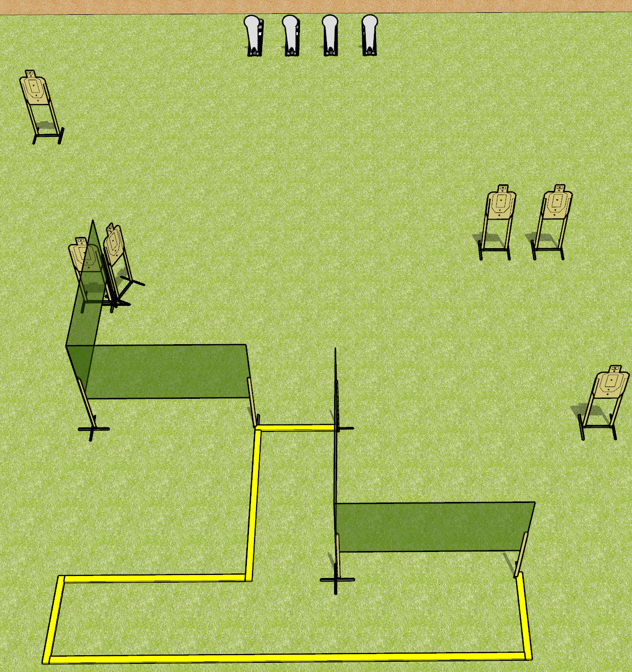
 | Dothan Gun Club – USPSA Match Hang On, What? Course Designer : Drew Coleman
Round Count 16 rounds 6 USPSA targets 4 colt poppers
Equipment List 3 medium fault lines 6 wall feet
XX

Slide 6
Hang On, What?
Written Stage Briefing
Hang On What is an 16 round, 80 point, Comstock course of fire. There are 6 USPSA targets and 4 colt poppers. The best 2 hits on paper will score, and steel must fall to score. The start signal is audible.
Handgun start position is feet on X’s, wrists below belt. Handgun is loaded and holstered.
PCC start position is feet on X’s, stock on belt. Loaded carbine is held with both hands.
On start signal, engage targets as they become available from within the shooting area.

